Slide 1

Praat Workshop -Intermediate-
Yuka Tatsumi
Penn State CLS Lab Manager

Slide 2
Overview of Today
Introducing Praat Scripting--what is it?
Basic syntax
Hands-on Practice!!
Other Implementations you can use with scripting knowledge

Slide 3
Part 1
Introducing Praat Scripting

Slide 4
What is Praat Scripting?
- Allows you to automate any processing you can do with GUI
- It is a programming language (a human-friendly one!) just for Praat
- you could use others' script online...but learning how to script by yourself can really help you understand others' scripts, and apply others' scripts to your data
Part 1. Intro: p1/7

Slide 5
What can you do with Praat Scripting?
Answer: you can do anything you can do with Praat GUI
-- and can handle a lot of data!
Analyze speech
- spectrogram
- formants
- pitch
- intensity
- voice quality
- labelling by
- phonemes
- words
- turns...etc.
Manipulate speech
- copy and paste sounds
- change
- intensity,
- pitch
- duration...etc.
- filtering
- synthesize speech
Speech data processing
- Get a table of acoustic measures
- Get graphics of
- vowel space
- spectrum slices
- LPC slices...etc.
- Stats
Part 1. Intro: p2/7

Slide 6
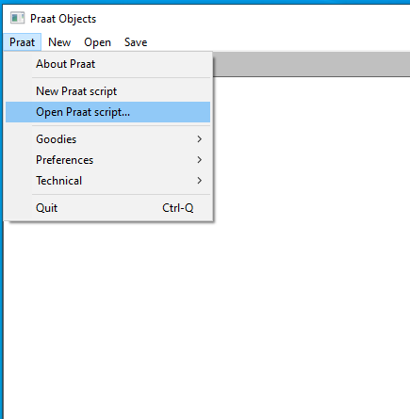
Let's look at an example script
1. Open an existing script
0. Download/copy&paste
the script from here
https://github.com/yukat237/Praat_Workshop/blob/main/Saving%20sound%20objects%20as%20wav%20files
Part 1. Intro: p3/7

Slide 7
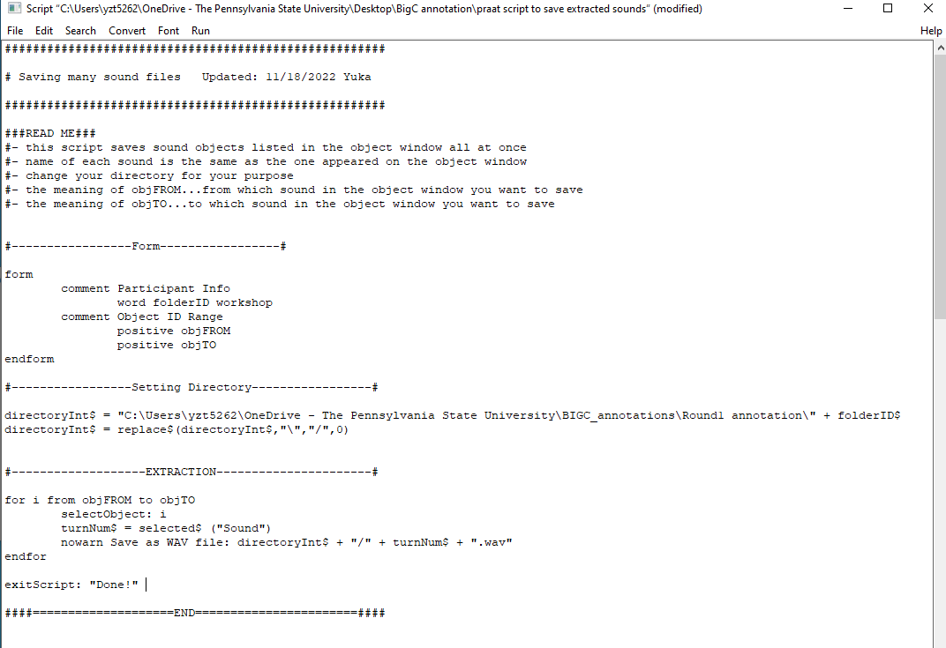
praat script to save sound objects.
Part 1. Intro: p4/7

Slide 8
General Script Structure
1. Title, Readme, Dates, Rights
2-1. Set up a "form" window
2-2. Set up the directory
2. Body script
2-3. Loops
- "I will repeat the same action below, for this input to that output"
- "import this sound, grab click on that object, do this function"
- "I save that
2-4. Producing products (Writing out)
*None of these is obligatory!
Part 1. Intro: p6/7

Slide 9
praat script to save extracted sounds.
1
2.1
2.2
2.3 + 2.4
Part 1. Intro: p7/7

Slide 10
Part 2
Basic Syntax

Slide 11
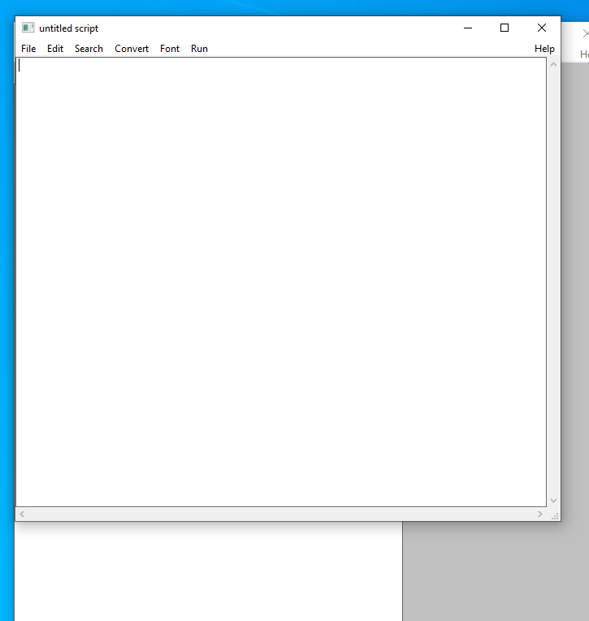
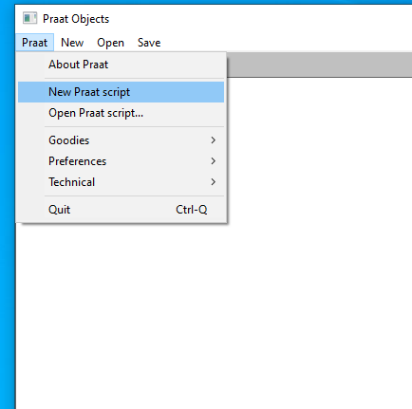
Getting started with your new script
1. Open a new script
2. this is your canvas!
Part 2. Intro: p1/17

Slide 12
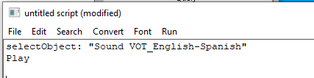
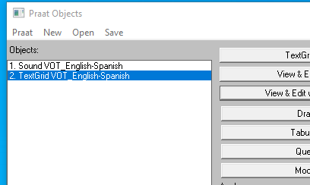
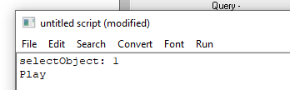
Let's write a simple script (Play Sound)
Prep: Import a sound to Object Window
(VOT_EnglishSpanish.wav & .TextGrid)
1. Write this and Run (Ctrl + R)
Object name
OR
Object number
Object name
Object number
Part 2. Intro: p2/17

Slide 13
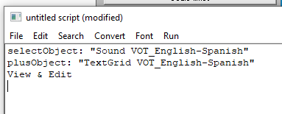
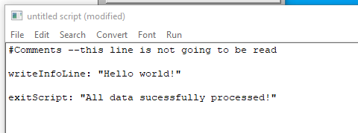
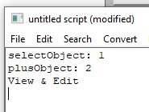
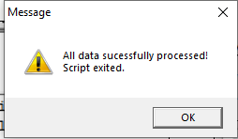
Let's write a simple script (View&Edit, and more)
2. Write this and Run (Ctrl + R)
3. Use "#" for comments.
4. "Print" function in Praat is "writeInfoLine: "
(but I use "exitScript: " more often)
OR
WriteInfoLine...opens another script (as a text file)
ExitScript...pop-up message
Part 2. Intro: p3/17

Slide 14
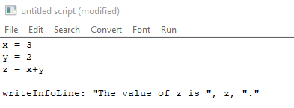
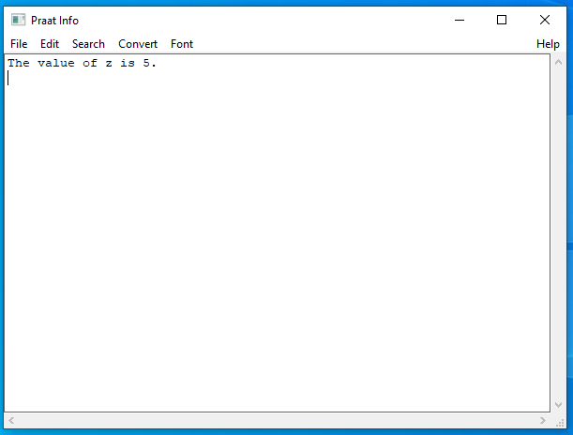
Let's write a simple script (Calculations)
1. Write this and Run (Ctrl + R)
2. this script will produce:
Terms:
You assigned the value of 3 to the variable x.
Part 2. Intro: p4/17

Slide 15
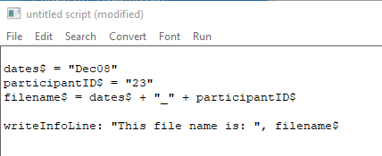
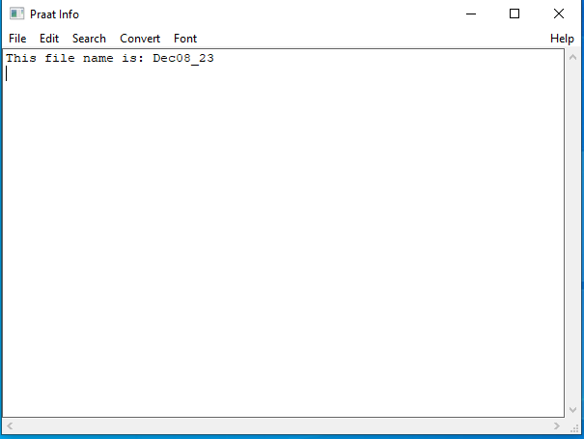
Let's write a simple script (Texts)
1. Write this and Run (Ctrl + R)
2. this script will produce:
Part 2. Intro: p5/17

Slide 16
Summary of Variables in Praat
"letters" … String Variable
General Rules:
- All variables must start with lower-case
- Define variables with an equal sign
- functions can follow after "variable = "
Variable names end with "$".
Assigned values are marked with quotes (" ")
"numbers" … Numeric Variable
Praat is case sensitive!
Variable names end as it is.
Assigned values are the bare numbers.
Praat is not whitespace sensitive.
(ignores spaces & indents)
Indentation is used sorely for readability!
Praat is tab sensitive!
Save the script frequently!
Part 2. Intro: p6/17

Slide 17
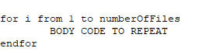
Loops
Meaning→ Repeat the code wrapped within "for" and "endfor," for the known number of times.
Basic Idea
This code means:
"Repeat 'BODY CODE TO REPEAT' from i = 1 to i = the number value in the variable 'numberOfFiles'
"i"...this is an empty box to save which number you are at when repeating the loop. this can be any alphabet. It is "i" by convention.
Another option: for i to variable (starts from i = 1)
Part 2. Intro: p7/17

Slide 18
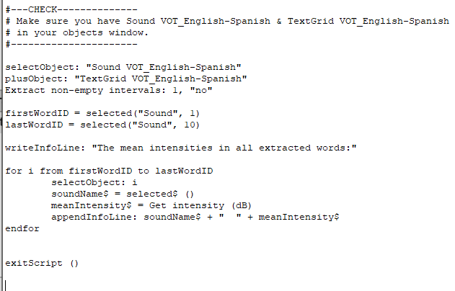
Let's try running a loop
Readme
Extract sounds based on tier 1 (by Word segmentation)
Get unique IDs of 1st and 10th words
Prep an Info window to write results on
FOR LOOP
https://github.com/yukat237/Praat_Workshop/blob/main/List%20Intensities%20(Let's%20try%20running%20a%20loop%20slide)
Part 2. Intro: p8/17

Slide 19
Let's try running a loop
Readme
Extract sounds based on tier 1 (by Word segmentation)
Get unique IDs of 1st and 10th words
Prep an Info window to write results on
Select the extracted sound #i
FOR LOOP
set soundName variable (getting extracted sound name)
Set meanIntensity variable as string (using Function)
Adding line on the info window
Part 2. Intro: p9/17

Slide 20
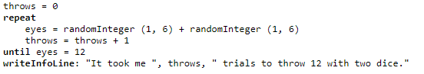
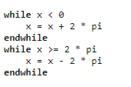
Other loops
Run the code repeatedly, until the condition is met.
Repeat - until
while - endwhile
less common than For Loops, but useful.
Part 2. Intro: p10/17

Slide 21
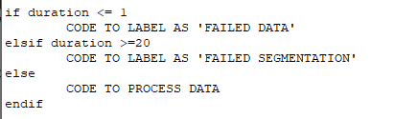
Jumping depending on conditions "if statement"
Basic Idea
Condition to run the following code
1 if/else section
Another condition to run the following code
Otherwise, run the following code
This code means:
1) if duration is less than 1, label that data as 'failed data.'
2) if duration is more than 20, label that data as 'failed segmentation'
3) Otherwise, process data as a good quality data
Especially useful when you want to force the code to skip some data with errors!
Part 2. Inro: p11/17

Slide 22
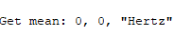
Various Commands
Command
to get a mean pitch from "Pitch" object
Arguments
- Refresher -
Object types
Sound ______
TextGrid ______
Spectrogram ______
Spectrum ______
Pitch ______
Formant_______
Intensity_______
Question is...
How do I know what these arguments mean?
Part 2. Intro: p12/17

Slide 23
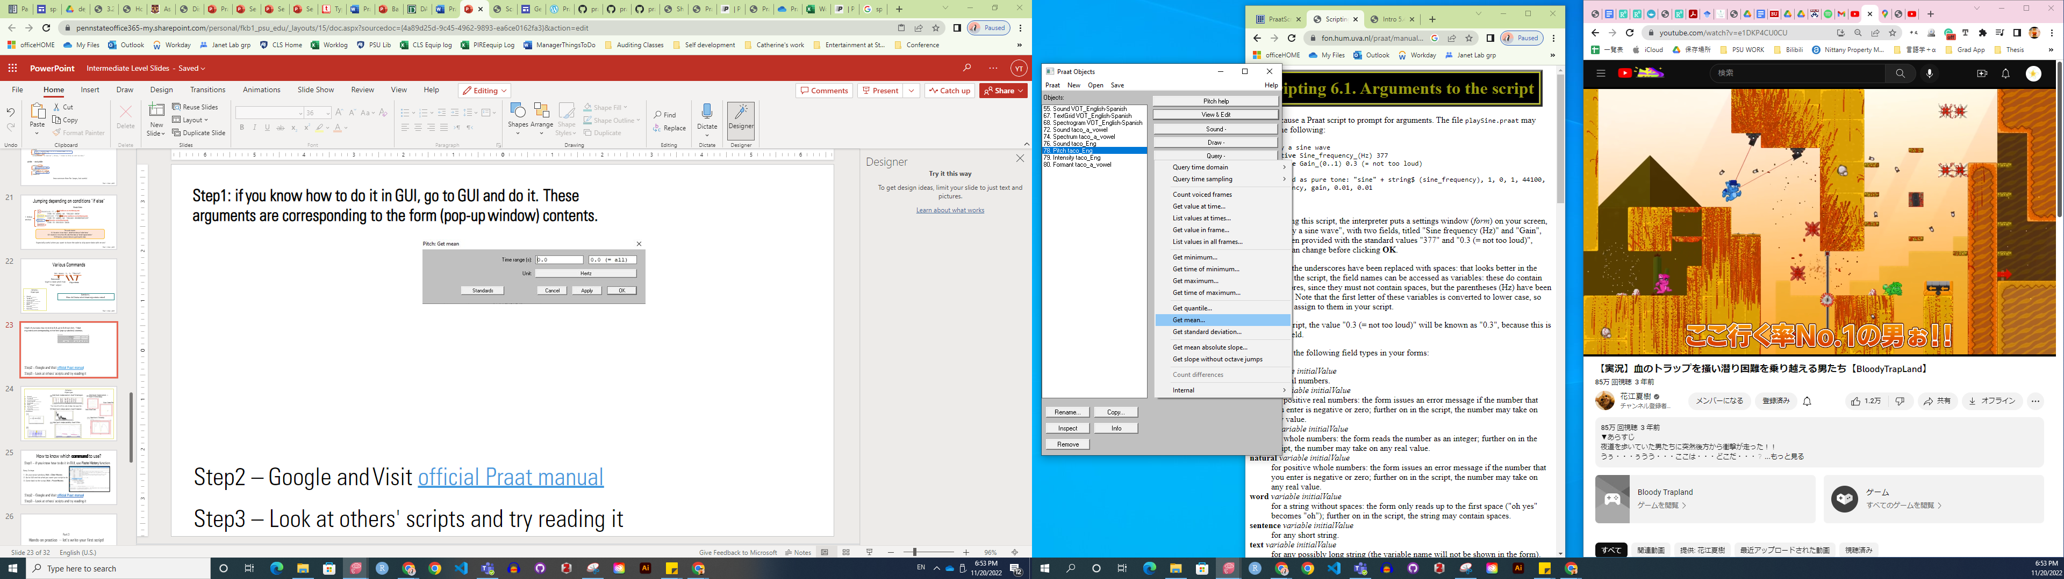
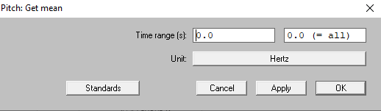
Method1: if you know how to do it in GUI, go to GUI and do it. These arguments are corresponding to the form (pop-up window) contents.
Method2 – Google and Visit official Praat manual
Method3 – Look at others' scripts and try reading it
Part 2. Intro: p13/17

Slide 24
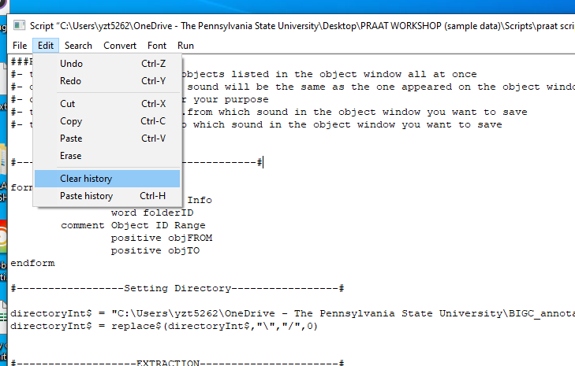
How to know which command to use, first of all?
Method1 – if you know how to do it in GUI, use Paste History function
Easy 3 steps:
1. On your script window, Edit > Clear History
2. Go to GUI and do what you want your script to do
3. Come back to the script, Edit > Paste History
Method2 – Google and Visit official Praat manual
Method3 – Look at others' scripts and try reading it
Part 2. Intro: p14/17

Slide 25
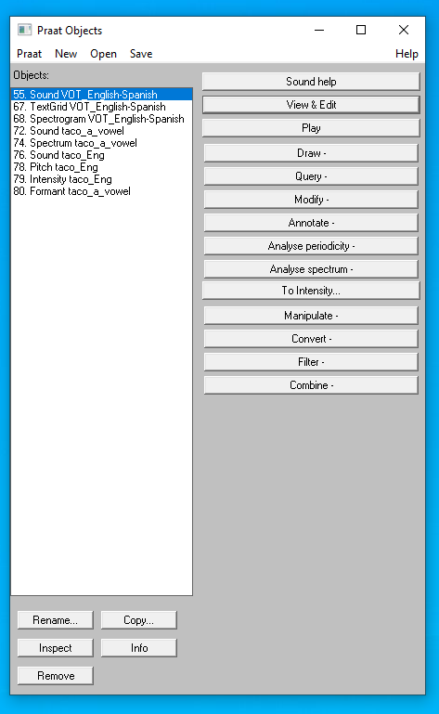
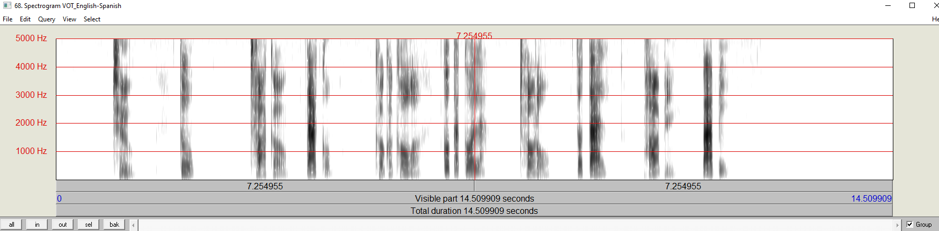
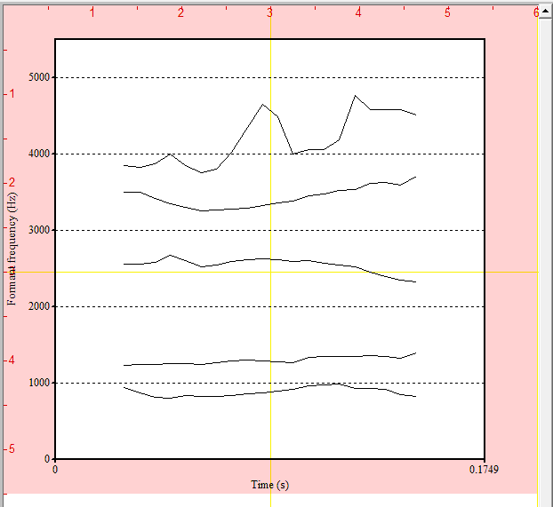
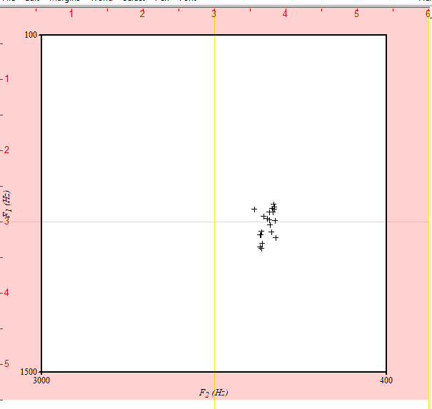
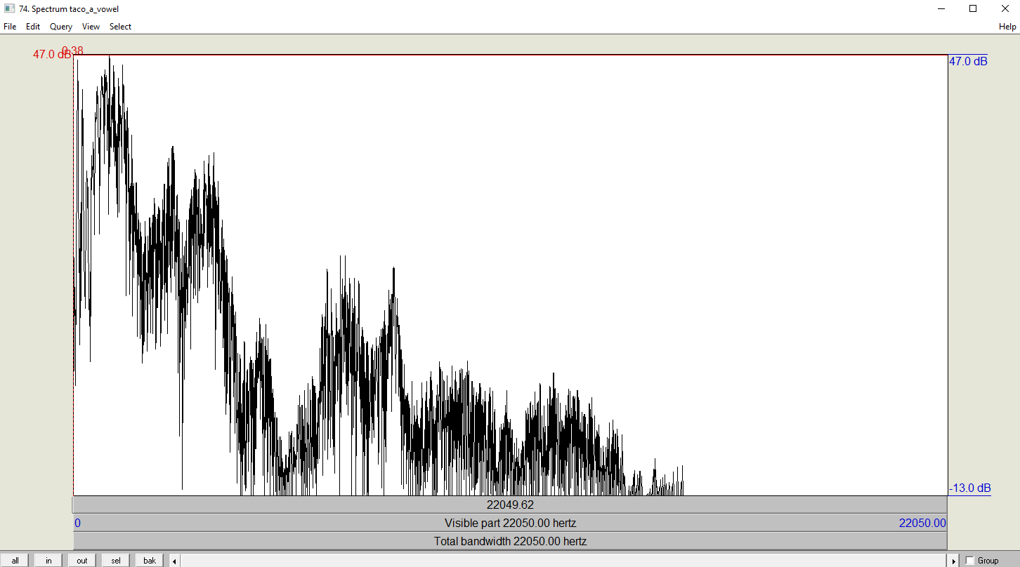
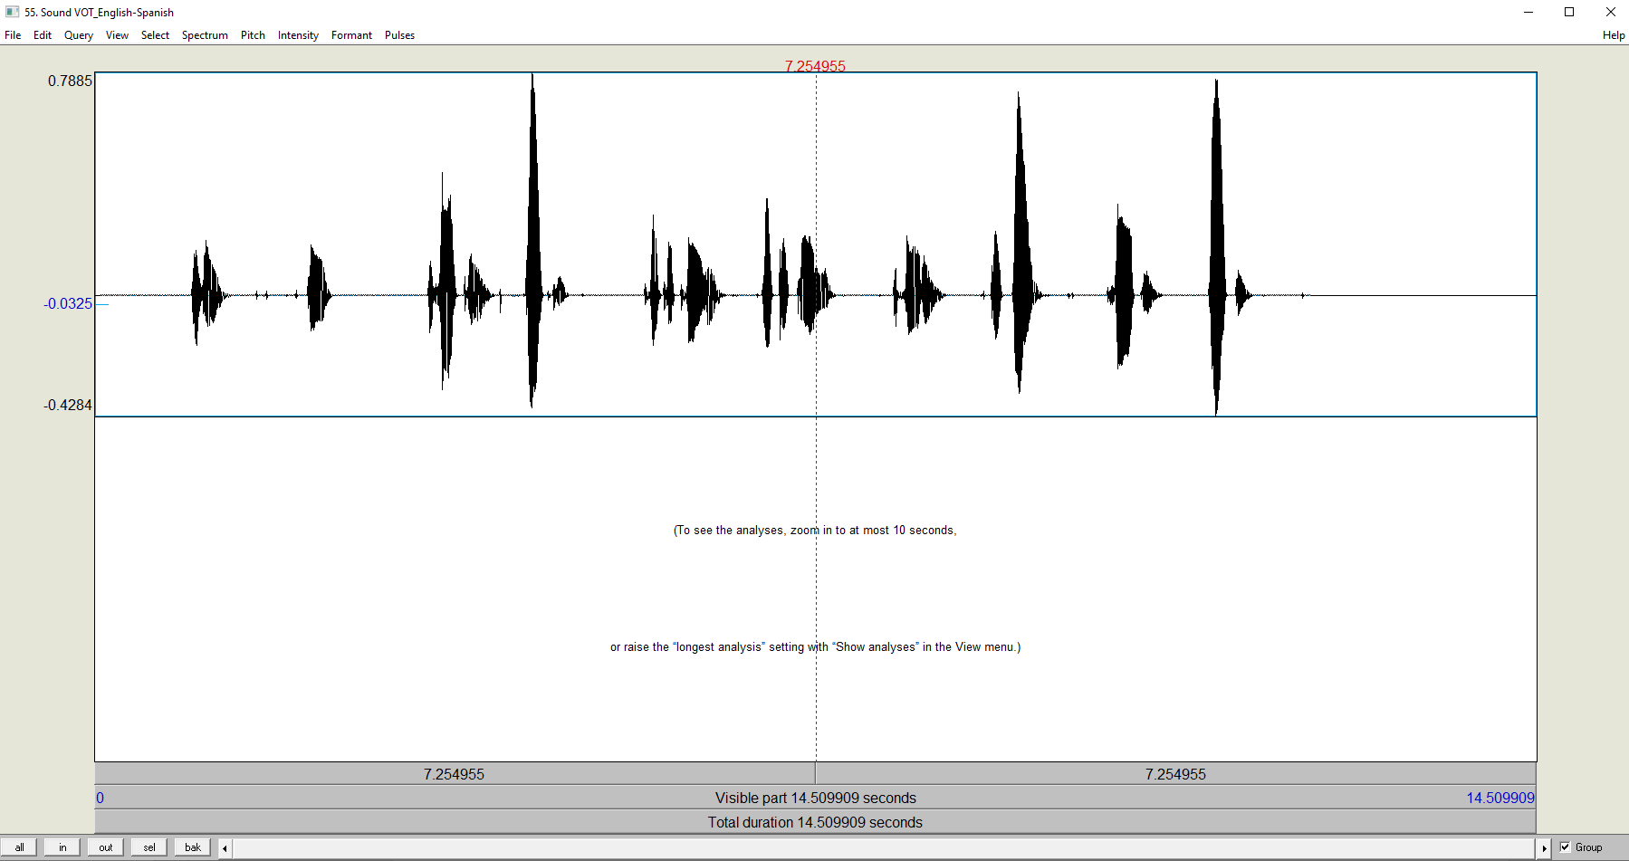
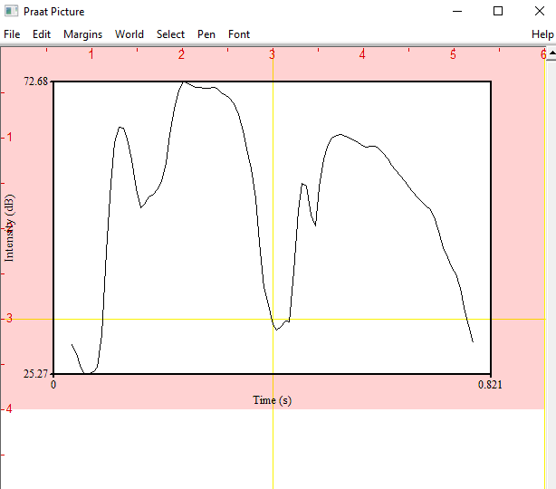
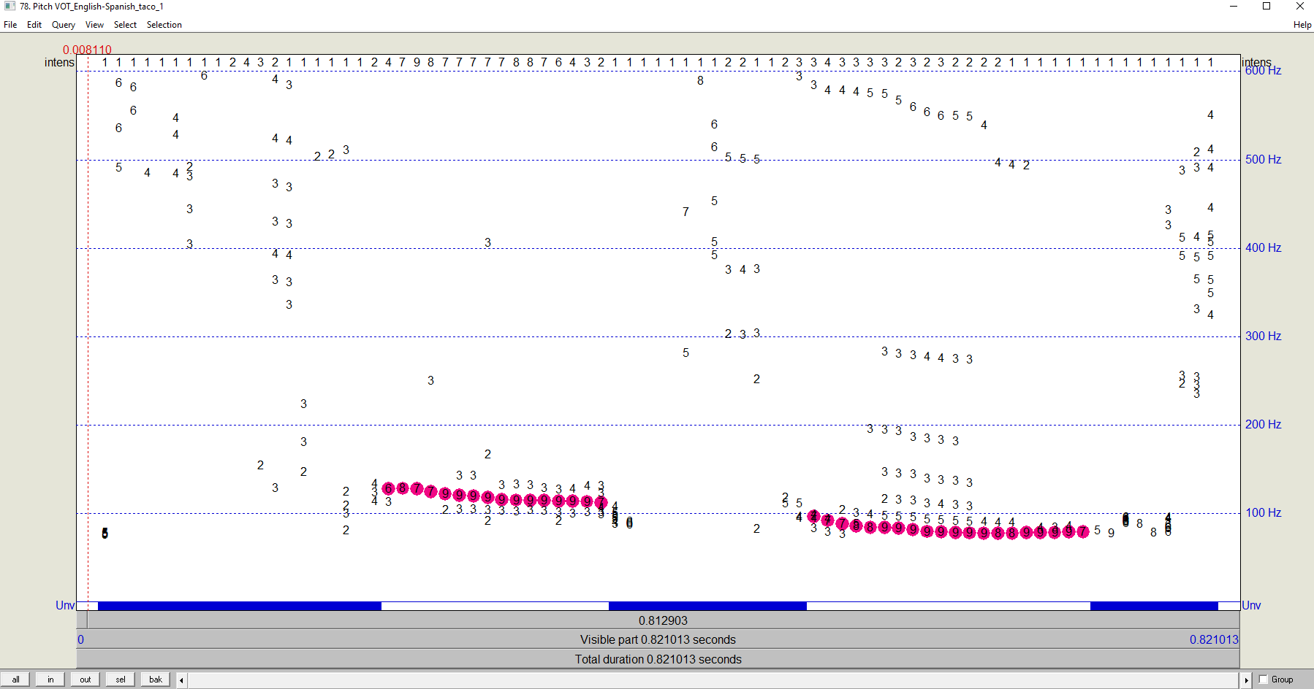
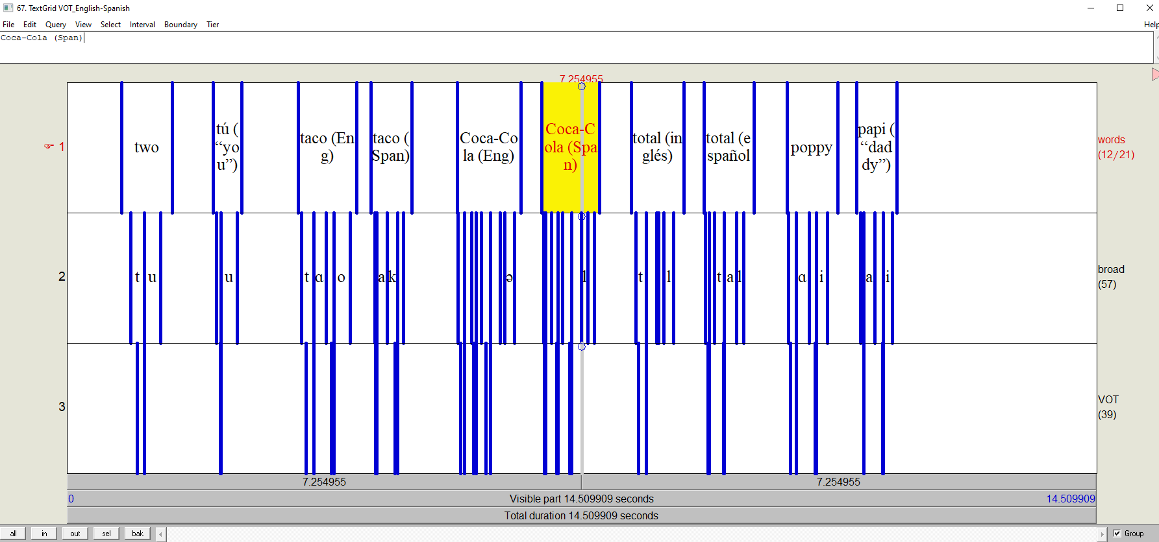
- Refresher -
Object types
Sound ______
TextGrid ______
Spectrogram ______
Spectrum ______
Pitch ______
Formant_______
Intensity_______
[3]
Select Sound > Analsyze spectrum > Sound: To Spectrogram...
[6]
Select Sound > Analyze spectrum... >
Sound: To Formant (burg)...
Draw > Scatter Plot
*Draw this onto Picture Window; select this object > Spectrogram: Paint...
[4]
Select Sound > Analsyze spectrum > Sound: To Spectrum...
Draw > Draw Tracks
[1]
[7]
Select Sound > To Intensity...
[5]
Select Sound > Analsyze periodicity > Sound: To Pitch...
[2]
Part 2. Intro: p15/17

Slide 26
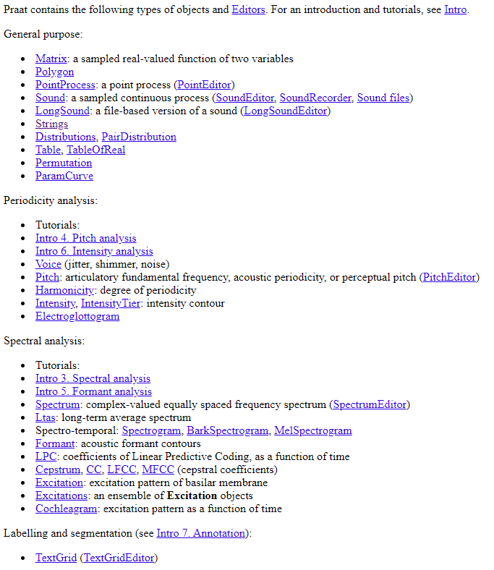
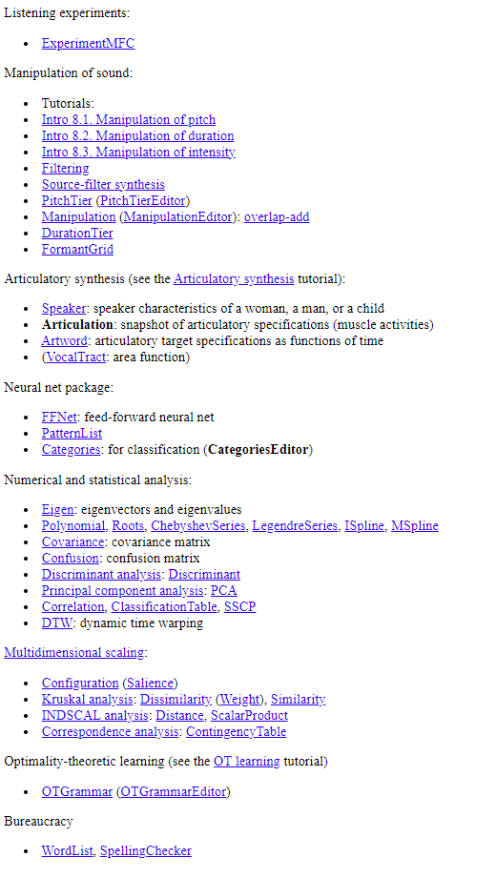
- Refresher -
Object types
...and MORE!!!
https://www.fon.hum.uva.nl/praat/manual/Types_of_objects.html
Part 2. Intro: p16/17

Slide 27
Regular Expression
Regex list:
https://www.fon.hum.uva.nl/praat/manual/Regular_expressions_1__Special_characters.html
Part 2. Intro: p17/17

Slide 28
Part 3
Hands-on practice -- let's write a full script!

Slide 29

Part 3
Hands-on practice -- let's write a full script!
The process of writing the script explained here is reflecting my real flow of thoughts-- it is not the top-to-bottom writing, which might not be your preference, but I thought presenting an authentic writing process would be helpful to who has no background in coding

Slide 30
Plan the structure
Think about:
1) what kind of data you have (input)
2) what products you want to make (output)
Then, write the overall structure with #(comments function)
on a new script

Slide 31
Practice Input & Output
Example:
1. I have a lot of sentence stimuli and I want to normalize its intensity
--> input = sounds, output = sounds
2. I have spontaneous speech data and want to automatically segment all the speech by words and phonemes
--> input = sounds, output = TextGrid
3. I have word production data and want to get acoustic measures of various kinds
--> input = sound, output = a table or text file
4. I have a set of TextGrids with manually segmented by words and excel sheets of their responses, and I want to label them with the words by referring to the excel sheets.
--> input = text file made out of excel sheets, sounds, and Textgrids; Output = updated textgrids
5. I want to extract sounds from the data based on the segments on the Textgrid and save all the new sounds
--> input = sound and textgrid, output = sound files (.wav)

Slide 32
Practice Input & Output
Example:
1. I have a lot of sentence stimuli and I want to normalize its intensity
--> input = sounds, output = sounds
2. I have spontaneous speech data and want to automatically segment all the speech by words and phonemes
--> input = sounds, output = TextGrid
3. I have word production data and want to get acoustic measures of various kinds
--> input = sound, output = a table or text file
4. I have a set of TextGrids with manually segmented by words and excel sheets of their responses, and I want to label them with the words by referring to the excel sheets.
--> input = text file made out of excel sheets, sounds, and Textgrids; Output = updated textgrids
5. I want to extract sounds from the data based on the segments on the Textgrid and save all the new sounds
--> input = sound and textgrid, output = sound files (.wav)

Slide 33
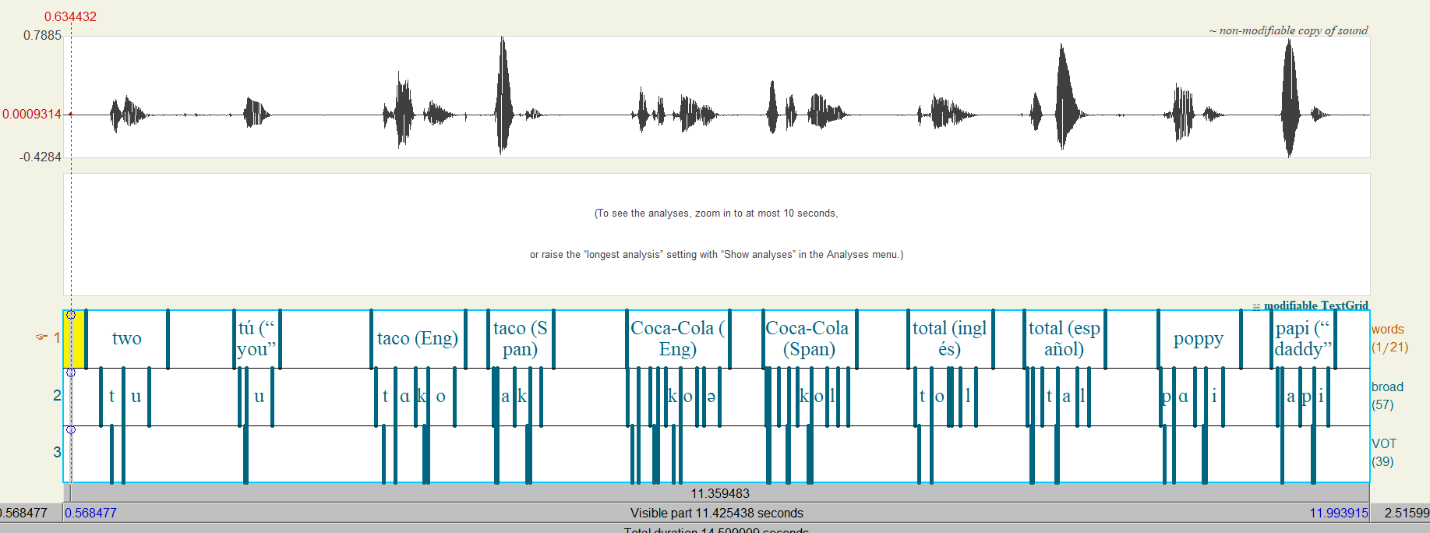
A script we try together today
You have this sound file annotated by words, (broadly transcribed) phonemes, and VOT.
You want to extract each sound, normalize the intensity, and save them as separate sound files.
Also, you want to get data of VOT duration.
--reminder--
3 things you can do with Praat
Analyze sound
Manipulate sound
Data Process of sound
Notes:
Scale intensity
Resampling
Bandpass filtering
Extract 1 channel (stereo to mono)
….

Slide 34
Step1: think about inputs and outputs
You have this sound file annotated by words, (broadly transcribed) phonemes, and VOT.
You want to extract each sound, normalize the intensity, and save them as separate sound files.
Also, you want to get data of VOT duration
Input
Output
You have:
- 1 sound file
- 1 TextGrid (with 3 tiers)
You want:
- 10 .wav files for each word (with Intensity normalized) in your local folder
- 1 table with VOT duration data on it
Notes:
Scale intensity
Resampling
Bandpass filtering
Extract 1 channel (stereo to mono)
….

Slide 35
2. Structure - think of what you would do with GUI
Input
Output
You have:
- 1 sound file
- 1 TextGrid (with 3 tiers)
You want:
- 10 .wav files for each word (with Intensity normalized) in your local folder
- 1 table with VOT duration data
Structure
Starting point: Original sound file and TextGrid is in the object window
Body:
Extract the sounds word by word based on the word tier
For each extracted sound...
normalize intensity
save as .wav file
For each TextGrid interval...
Get VOT duration
Get word & phoneme information for this VOT
Record these in a table
word | phoneme | VOT
Two (En) | t | 0.1
Tu (Sp) | t | 0.02
... | ... | ...
Goal is something like:
Notes:
Scale intensity
Resampling
Bandpass filtering
Extract 1 channel (stereo to mono)
….

Slide 36
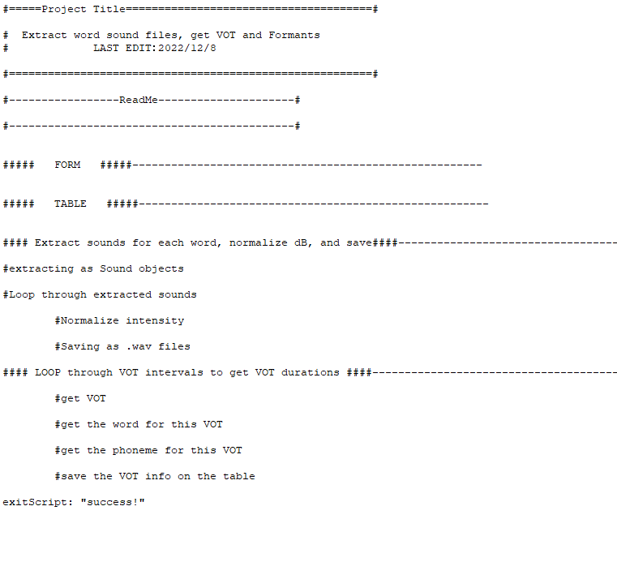
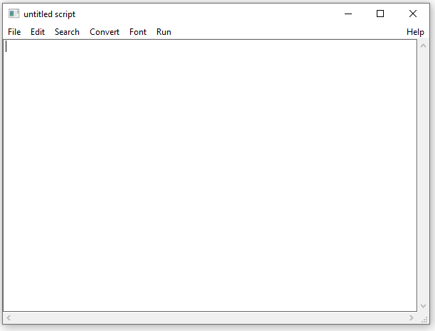
Step3: write the structure down in a new script
2. Write down your plan with "#"
1. Open a new script
(Praat > New Praat Script)
(the full script is HERE)
Notes:
Scale intensity
Resampling
Bandpass filtering
Extract 1 channel (stereo to mono)
….

Slide 37
#=====Project Title======================================#
# Extract word sound files, get VOT and Formants
# LAST EDIT：2022/12/8
#========================================================#
#-----------------ReadMe---------------------#
#--------------------------------------------#
##### FORM #####------------------------------------------------------
##### TABLE #####------------------------------------------------------
#### Extract sounds for each word, normalize dB, and save####---------------------------------------------------
#extracting as Sound objects
#Loop through extracted sounds
#Normalize intensity
#Saving as .wav files
#### LOOP through VOT intervals to get VOT durations ####---------------------------------------------------
#get VOT
#get the word for this VOT
#get the phoneme for this VOT
#save the VOT info on the table
exitScript: "success!"
Project Title, Dates, Your Name
Read Me (Notes for others & future self)
Form
Prepping Table
Extract sounds, Loop through them to normalize dB, Save.
BODY
Loop through Tier3 intervals (VOT tier) to get VOT duration data
Notes:
Scale intensity
Resampling
Bandpass filtering
Extract 1 channel (stereo to mono)
….

Slide 38
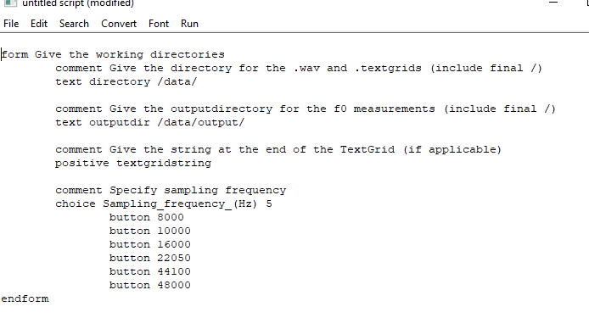
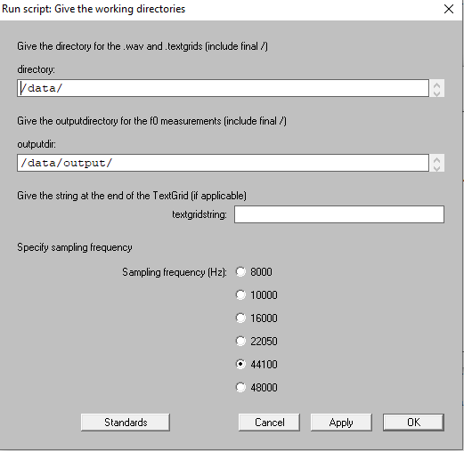
Step4: Write a form
Form in Praat is something looks like this:
You get the form on the left from this kind of coding
Form is helpful to generalize the script's use, and manually change how you want code to behave without going back to the code.
Notes:
Scale intensity
Resampling
Bandpass filtering
Extract 1 channel (stereo to mono)
….

Slide 39
Step4: Write a form
For our purpose, let's write this:
Surrounding by "form" -- "endform" makes a form.
Hit Run to see how this looks like!
form Title of this form
sentence sound_object_name VOT_EnglishSpanish
positive target_intensity 70
comment Where the sound should be saved?
text folderDir Folder path to save your sounds
endform
** Gray & Italicized words...you decide what to type!
Notes:
Scale intensity
Resampling
Bandpass filtering
Extract 1 channel (stereo to mono)
….

Slide 40
Step4: Write a form
For our purpose, let's write this:
Surrounding by "form" -- "endform" makes a form.
Hit Run to see how this looks like!
form Title of this form
sentence sound_object_name VOT_EnglishSpanish
positive target_intensity 70
comment Where the sound should be saved?
text folderDir Folder path to save your sounds
endform
variable
Default in textbox
variable
variable
Default in textbox
** Gray & Italicized words...you decide what to type!
Notes:
Scale intensity
Resampling
Bandpass filtering
Extract 1 channel (stereo to mono)
….

Slide 41
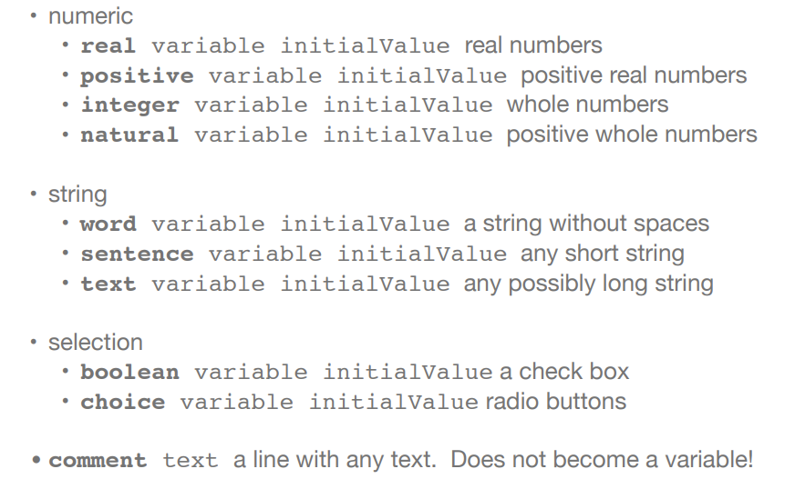
FYI: field types for the form
https://www.linguisticsociety.org/sites/default/files/e-learning/Day7.pdf

Slide 42
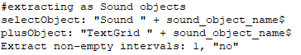
Step5: Write a code to extract each sound
If it's GUI, you would:
1) select sound object and the TextGrid
2) click on "Extract" > "Extract the non-empty intervals"
3) choose the tier you want to refer to.
4) all sounds listed as Sound objects in the object window.
Tier Number
variable
Notes:
Scale intensity
Resampling
Bandpass filtering
Extract 1 channel (stereo to mono)
….

Slide 43
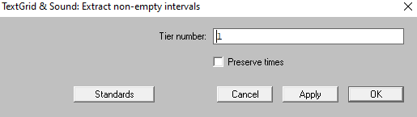
Step5: Write a code to extract each sound
Corresponding with what you will see in GUI!
Notes:
Scale intensity
Resampling
Bandpass filtering
Extract 1 channel (stereo to mono)
….

Slide 44
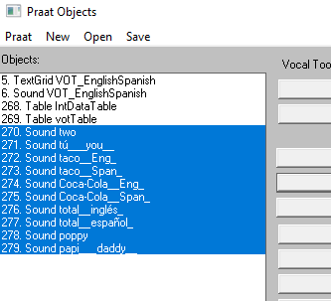
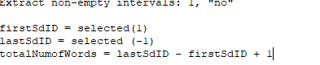
Step6: Loop through extracted sounds to normalize dB
If you run the 3 lines, you will get extracted sounds as Sound object, all selected.
When you loop through these sounds, you want to know the ID of these sounds. But that depends on how many objects you have already made. So, let's write a script to get the ID of these.
Notes:
Scale intensity
Resampling
Bandpass filtering
Extract 1 channel (stereo to mono)
….

Slide 45
Step6: Loop through extracted sounds to normalize dB
for i from firstSdID to lastSdID
#Normalize intensity
selectObject: i
nameOfSdObj$ = selected$ ("Sound")
oldInt = Get intensity (dB)
Scale intensity... 'target_intensity'
#Saving as .wav files
Save as WAV file: folderDir$ + "\" + nameOfSdObj$ + ".wav"
diffOfInt = 70 - oldInt
endfor
Notes:
Scale intensity
Resampling
Bandpass filtering
Extract 1 channel (stereo to mono)
….

Slide 46
Step6: Loop through extracted sounds to normalize dB
for i from firstSdID to lastSdID
#Normalize intensity
selectObject: i
nameOfSdObj$ = selected$ ("Sound")
oldInt = Get intensity (dB)
Scale intensity... 'target_intensity'
#Saving as .wav files
Save as WAV file: folderDir$ + "\" + nameOfSdObj$ + ".wav"
diffOfInt = 70 - oldInt
endfor
Select sound object
Get the name of sound object (for later use)
get original intensity and save it into the variable "oldInt"
Normalizing Intensity to 70dB (as entered in the form)
Save sound as .wav
In the folder you entered in the form
Get the Intensity difference with original dB and save it into the variable "diffOfInt"
Notes:
Scale intensity
Resampling
Bandpass filtering
Extract 1 channel (stereo to mono)
….

Slide 47
Step6: Loop through extracted sounds to normalize dB
for i from firstSdID to lastSdID
#Normalize intensity
selectObject: i
nameOfSdObj$ = selected$ ("Sound")
oldInt = Get intensity (dB)
Scale intensity... 'target_intensity'
#Saving as .wav files
Save as WAV file: folderDir$ + "\" + nameOfSdObj$ + ".wav"
diffOfInt = 70 - oldInt
selectObject: tableID1
Append row
tblrow = Get number of rows
Set string value: tblrow, "word", nameOfSdObj$
Set numeric value: tblrow, "OldIntensity", oldInt
Set numeric value: tblrow, "Difference", diffOfInt
endfor
Optionally, let's make a table to save the word, original intensity, & the difference of the intensity
We have not made the table object yet, so let's make one right below the form! (next slide)
*Gray...parts you already typed with the previous slide
Notes:
Scale intensity
Resampling
Bandpass filtering
Extract 1 channel (stereo to mono)
….

Slide 48
Step6: Loop through extracted sounds to normalize dB
for i from firstSdID to lastSdID
#Normalize intensity
selectObject: i
nameOfSdObj$ = selected$ ("Sound")
oldInt = Get intensity (dB)
Scale intensity... 'target_intensity'
#Saving as .wav files
Save as WAV file: folderDir$ + "\" + nameOfSdObj$ + ".wav"
diffOfInt = 70 - oldInt
selectObject: tableID1
Append row
tblrow = Get number of rows
Set string value: tblrow, "word", nameOfSdObj$
Set numeric value: tblrow, "OldIntensity", oldInt
Set numeric value: tblrow, "Difference", diffOfInt
endfor
Optionally, let's make a table to save the word, original intensity, & the difference of the intensity
We have not made the table object yet, so let's make one right below the form! (next slide)
"I am adding a row!"
How many row exists?
On "word" column, add this nameOfSdObj$ string
On "OldIntensity" column, add this oldInt number value
On "Difference" column, add this diffOfInt number value
*Gray...parts you already did typed with the previous slide
Notes:
Scale intensity
Resampling
Bandpass filtering
Extract 1 channel (stereo to mono)
….

Slide 49
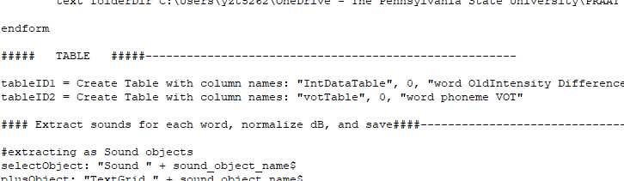
Step6: Loop through extracted sounds to normalize dB
Let's make the table below the Form section, to keep Intensity information!
Also, we know we want one table for VOT, so let's make that too.
Notes:
Scale intensity
Resampling
Bandpass filtering
Extract 1 channel (stereo to mono)
….

Slide 50
Step6: Loop through extracted sounds to normalize dB
Let's make the table below the Form section, to keep Intensity information!
Also, we know we want one table for VOT, so let's make that too.
Naming Table Object
# of row
List of column names (space = end of name)
Notes:
Scale intensity
Resampling
Bandpass filtering
Extract 1 channel (stereo to mono)
….

Slide 51
We are halfway through :)

Slide 52
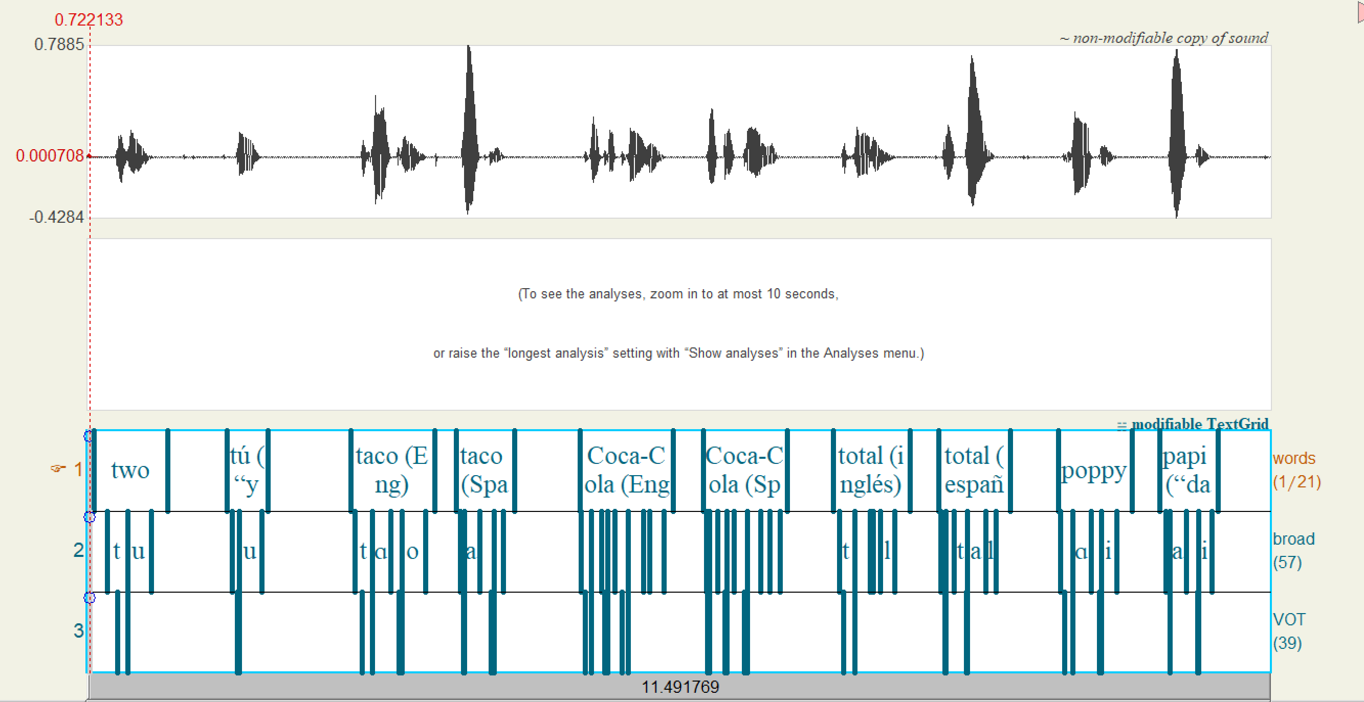
Step7: Get VOT and save the info in the table
The plan: loop should check each interval on Tier3, from left to right, and get duration of the interval only if the interval has the label "VOT" in it.
Notes:
Scale intensity
Resampling
Bandpass filtering
Extract 1 channel (stereo to mono)
….

Slide 53
Step7: Get VOT and save the info in the table
1. make a for loop.
selectObject: "TextGrid " + sound_object_name$
nVOT = Get number of intervals: 3
for i to nVOT
selectObject: "TextGrid " + sound_object_name$
labelT3$ = Get label of interval: 3, i
if labelT3$ = "VOT"
startTime = Get start time of interval: 3, i
endTime = Get end time of interval: 3, i
votDur = endTime - startTime
#save the VOT info
endif
endfor
Notes:
Scale intensity
Resampling
Bandpass filtering
Extract 1 channel (stereo to mono)
….

Slide 54
Step7: Get VOT and save the info in the table
1. make a for loop.
selectObject: "TextGrid " + sound_object_name$
nVOT = Get number of intervals: 3
2. Make "nVOT" variable. (we want this for-loop to continue for the total # of tier3 intervals. So, get that by Get number of intervals)
for i to nVOT
selectObject: "TextGrid " + sound_object_name$
labelT3$ = Get label of interval: 3, i
if labelT3$ = "VOT"
startTime = Get start time of interval: 3, i
endTime = Get end time of interval: 3, i
votDur = endTime - startTime
#save the VOT info
endif
endfor
Notes:
Scale intensity
Resampling
Bandpass filtering
Extract 1 channel (stereo to mono)
….

Slide 55
Step7: Get VOT and save the info in the table
1. make a for loop.
selectObject: "TextGrid " + sound_object_name$
nVOT = Get number of intervals: 3
2. Make "nVOT" variable. (we want this for-loop to continue for the total # of tier3 intervals. So, get that by Get number of intervals)
for i to nVOT
selectObject: "TextGrid " + sound_object_name$
labelT3$ = Get label of interval: 3, i
if labelT3$ = "VOT"
startTime = Get start time of interval: 3, i
endTime = Get end time of interval: 3, i
votDur = endTime - startTime
#save the VOT info
endif
endfor
3. select TextGrid
Notes:
Scale intensity
Resampling
Bandpass filtering
Extract 1 channel (stereo to mono)
….

Slide 56
Step7: Get VOT and save the info in the table
4. get the VOT label
(1st argument: tier 3
2nd argument: interval number counting from left)
And save it in the variable "labelT3$"
selectObject: "TextGrid " + sound_object_name$
nVOT = Get number of intervals: 3
for i to nVOT
selectObject: "TextGrid " + sound_object_name$
labelT3$ = Get label of interval: 3, i
if labelT3$ = "VOT"
startTime = Get start time of interval: 3, i
endTime = Get end time of interval: 3, i
votDur = endTime - startTime
#save the VOT info
endif
endfor
Notes:
Scale intensity
Resampling
Bandpass filtering
Extract 1 channel (stereo to mono)
….

Slide 57
Step7: Get VOT and save the info in the table
4. get the VOT label
(1st argument: tier 3
2nd argument: interval number counting from left)
And save it in the variable "labelT3$"
selectObject: "TextGrid " + sound_object_name$
nVOT = Get number of intervals: 3
for i to nVOT
selectObject: "TextGrid " + sound_object_name$
labelT3$ = Get label of interval: 3, i
if labelT3$ = "VOT"
startTime = Get start time of interval: 3, i
endTime = Get end time of interval: 3, i
votDur = endTime - startTime
#save the VOT info
endif
endfor
5. write if statement.
(we do not need to get duration if it's empty, so checking if the label is "VOT"
Notes:
Scale intensity
Resampling
Bandpass filtering
Extract 1 channel (stereo to mono)
….

Slide 58
Step7: Get VOT and save the info in the table
selectObject: "TextGrid " + sound_object_name$
nVOT = Get number of intervals: 3
6. get duration and assign the value to votDur variable
(getting duration often involves 3 steps: get Start time, get End time, and do "End - Start")
for i to nVOT
selectObject: "TextGrid " + sound_object_name$
labelT3$ = Get label of interval: 3, i
if labelT3$ = "VOT"
startTime = Get start time of interval: 3, i
endTime = Get end time of interval: 3, i
votDur = endTime - startTime
#save the VOT info
endif
endfor
Notes:
Scale intensity
Resampling
Bandpass filtering
Extract 1 channel (stereo to mono)
….

Slide 59
Step7: Get VOT and save the info in the table
selectObject: "TextGrid " + sound_object_name$
nVOT = Get number of intervals: 3
7. Now we want to write the votDur value into the table! (same as the appending to table1, except the tableID2 and column names and the corresponding variables
for i to nVOT
selectObject: "TextGrid " + sound_object_name$
labelT3$ = Get label of interval: 3, i
if labelT3$ = "VOT"
startTime = Get start time of interval: 3, i
endTime = Get end time of interval: 3, i
votDur = endTime - startTime
#save the VOT info
selectObject: tableID2
Append row
tblrow = Get number of rows
Set string value: tblrow, "word", wordlabel$
Set string value: tblrow, "phoneme", phonlabel$
Set numeric value: tblrow, "VOT", votDur
endif
endfor
Notes:
Scale intensity
Resampling
Bandpass filtering
Extract 1 channel (stereo to mono)
….

Slide 60
Step7: Get VOT and save the info in the table
selectObject: "TextGrid " + sound_object_name$
nVOT = Get number of intervals: 3
for i to nVOT
selectObject: "TextGrid " + sound_object_name$
labelT3$ = Get label of interval: 3, i
if labelT3$ = "VOT"
startTime = Get start time of interval: 3, i
endTime = Get end time of interval: 3, i
votDur = endTime - startTime
#save the VOT info
selectObject: tableID2
Append row
tblrow = Get number of rows
Set string value: tblrow, "word", wordlabel$
Set string value: tblrow, "phoneme", phonlabel$
Set numeric value: tblrow, "VOT", votDur
endif
endfor
8. we need these 2 variables. That is, we want to know what was the word and the phoneme for the VOT we just measured (next slide!)
Notes:
Scale intensity
Resampling
Bandpass filtering
Extract 1 channel (stereo to mono)
….

Slide 61
Step7: Get VOT and save the info in the table
selectObject: "TextGrid " + sound_object_name$
nVOT = Get number of intervals: 3
8. make wordlabel$ and phonlabel$.
Each is looking at: "what is the interval number of Tier 1or2, at the start time of this VOT interval?" & "What is the label of that interval?
for i to nVOT
selectObject: "TextGrid " + sound_object_name$
labelT3$ = Get label of interval: 3, i
if labelT3$ = "VOT"
startTime = Get start time of interval: 3, i
endTime = Get end time of interval: 3, i
votDur = endTime - startTime
#get the word for this VOT
intervalNumOfWord = Get interval at time: 1, startTime
wordlabel$ = Get label of interval: 1, intervalNumOfWord
#get the phoneme for this VOT
intervalNumOfPhon =Get interval at time: 2, startTime
phonlabel$ = Get label of interval: 2, intervalNumOfPhon
#save the VOT info
selectObject: tableID2
Append row
tblrow = Get number of rows
Set string value: tblrow, "word", wordlabel$
Set string value: tblrow, "phoneme", phonlabel$
Set numeric value: tblrow, "VOT", votDur
endif
endfor
Notes:
Scale intensity
Resampling
Bandpass filtering
Extract 1 channel (stereo to mono)
….

Slide 62
Step7: Get VOT and save the info in the table
selectObject: "TextGrid " + sound_object_name$
nVOT = Get number of intervals: 3
for i to nVOT
selectObject: "TextGrid " + sound_object_name$
labelT3$ = Get label of interval: 3, i
if labelT3$ = "VOT"
startTime = Get start time of interval: 3, i
endTime = Get end time of interval: 3, i
votDur = endTime - startTime
#get the word for this VOT
intervalNumOfWord = Get interval at time: 1, startTime
wordlabel$ = Get label of interval: 1, intervalNumOfWord
#get the phoneme for this VOT
intervalNumOfPhon =Get interval at time: 2, startTime
phonlabel$ = Get label of interval: 2, intervalNumOfPhon
#save the VOT info
selectObject: tableID2
Append row
tblrow = Get number of rows
Set string value: tblrow, "word", wordlabel$
Set string value: tblrow, "phoneme", phonlabel$
Set numeric value: tblrow, "VOT", votDur
endif
endfor
Done!!! :)
Notes:
Scale intensity
Resampling
Bandpass filtering
Extract 1 channel (stereo to mono)
….

Slide 63
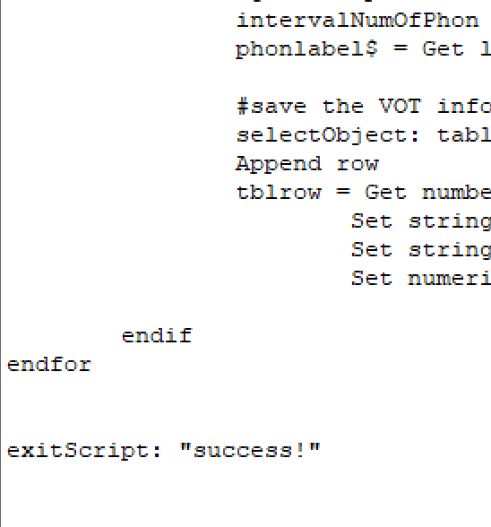
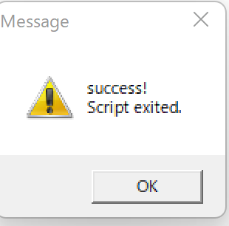
Option 1: exitScript
The clear sign of successful processing. Instead of the "success" , you can also write variables here to see their values.
Notes:
Scale intensity
Resampling
Bandpass filtering
Extract 1 channel (stereo to mono)
….

Slide 64
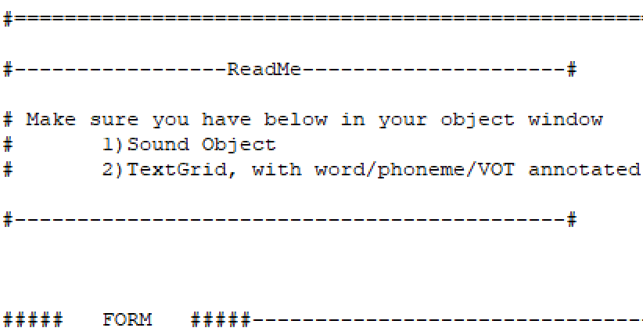
Option 2: write something in Read Me
For future self or any readers of your script, write down
- things users of the script have to do before running scripts
- what kind of data format you need to use it
- any notes about the form
In our case, the user has to have Sound obj and Tg obj in their object window. And TextGrid has to have 3 Tiers.
So I am writing these down.
Notes:
Scale intensity
Resampling
Bandpass filtering
Extract 1 channel (stereo to mono)
….

Slide 65

Option 3: Cleaning
Without cleaning, too many objects created through the porcess may be left in the object window.
In our case, for example,
these selected objects are not needed after the loop of saving them as wav files.
So, consider adding these 2 lines before closing for loop for extracted sounds:
Notes:
Scale intensity
Resampling
Bandpass filtering
Extract 1 channel (stereo to mono)
….

Slide 66
NOTE
Similarly to any other programming languages,
There are many ways to write scripts for 1 same goal.
Although there are "more efficient" scripts than others,
No script is "wrong" as long as it achieves the goal.

Slide 67
Part 4
Other Implementations you can use with scripting knowledge

Slide 68




Other kind of scripts available everywhere
My script:
Please see the reference page at the end of this powerpoint for more resources
Getting an acoustic measures table from sound files
Part 4. Intro: p1/8

Slide 69

Plugin
Vocal Toolkit
plugin with automated scripts for voice processing
Easy Steps!
1) Download a folder from here
2) Praat > Open Praat Script > "INSTALL.praat" in the folder > Run
3) Restart
Now you see this in the menu
Part 4. Intro: p2/8

Slide 70


Vocal Toolkit
"Copy"
"Process"
...for 2 sounds selection.
...any sound selections / Create new
Part 4. Intro: 3/8

Slide 71


Vocal Toolkit
Go to the website to check what algorithms are used
Find the command of your interest
Example: Copy > Vocal Tract Size
Explanations
References for algorithm
Part 4. Intro: p4/8

Slide 72

Forced Alignment
DARLA: automated vowel extraction
Semi-Automated Alignment & Extraction
Audio with transcriptions showing sentence or breath group boundaries (as TextGrids)
Audio with transcriptions in a plaintext file
Audio with aligned TextGrids, for formant extraction only
Completely Automated Vowel Extraction
Bed Word: Automated Interview Transcription via Deepgram
Audio with transcriptions provided by our in-house speech recognition
ASR evaluation
Part 4. Intro: p5/8

Slide 73
Forced Alignment
DARLA: automated vowel extraction
Title | Input | Output
1.1 force alignment of vowels and get formants info, from sound & TextGrid (recommended) | 1) sound file 2) manual transcription TextGrid (with sentence & breath group annotated) | Forced vowel alignment & Formants
1.2 get formants from sound & txt file | 1) sound file 2) transcript in plaintext file (.txt) (can be manual or autocreated) | formants
1.3 get formants from sound & textgrid | 1)sound 2)manually aligned TextGrid (word/phoneme) | Formants
2.1 Newer/more precise system (costs money $0.75/hr for a 3rd party system) | 1) deepgram account API key 2) Sound file | transcripts
2.2 their legacy recog system; using Montreal Forced Aligner & FAVE-Extract | sound file | transcripts
2.3 evaluate ASR transcription error rates at word/phoneme level | 1) Manual transcription as plain text file 2) ASR OR another manual transcription | Error rates for words, phonemes and stressed vowels
Part 4. Intro: p6/8

Slide 74



Parselmouth
Praat in Python!
(Link to the website)
To install:
Not this:
Part 4. Intro: 7/8

Slide 75



Parselmouth
Example from the website
Part 4. Intro: 8/8

Slide 76
[θæŋkju]!!
Reach out to me if you got any questions about Praat:)
yzt5262@psu.edu

Slide 77
References
I borrowed the idea of "Input" "Output" from the slides made by Dr. Eleanor Chodroff (https://www.eleanorchodroff.com/tutorial/PraatScripting.pdf)
Also, Listen Lab Praat scripts were very helpful to doublecheck my intensity manipulation script (https://www.youtube.com/watch?v=j5GDJs0st_Q) (by Dr.Matt Winn: http://www.mattwinn.com/)
Other references for both of my Intermediate and Basic level workshop are listed here (with my personal summary notes for each): Praat List of Resources.docx
https://pennstateoffice365-my.sharepoint.com/:w:/r/personal/fkb1_psu_edu/Documents/Box%20Migration%20Data/CLS_LabManagers/Software,%20Hardware,%20and%20Tech/Software%20Information/Praat/Praat_Workshop/Praat%20Workshop%20(Yuka)/Praat%20List%20of%20Resources.docx?d=w7c2e8428eb8e4640ac90bd8dc3137412&csf=1&web=1&e=ZFlPR4

Slide 78

A script we try today -part2-
You have this Diapix corpus data:
- spontaneous speech data between 2 people
- Sound (1 channel /person) & TextGrid (word & sound annotation)
- You have this Sound&TextGrid set for 22 pairs
You want:
- average formants values of each vowel, for each speaker
- total number of turns, for each speaker
Notes:
Scale intensity
Resampling
Bandpass filtering
Extract 1 channel (stereo to mono)
….

